Slide 1
La MANCHE Virtual Think Tank

Slide 2
Virtual Think Tank: Mission
represents an innovative internet based community which initiates and encourages sustainable dialogue on HE reforms among relevant stakeholders in the La MANCHE countries;
provides an online platform for consultation, networking, peer learning and exchange of good practices in the field of HE governance;
elaboration and promotion of a strategy for leading and managing change in higher education;
raising awareness on the European HE Modernization Agenda and the needs to stimulate and implement structural reforms in the higher education sector.

Slide 3
Virtual Think Tank: Vision
The La MANCHE Virtual Think Tank members will build a diverse sustainable community unifying the expertise of a wide range of various stakeholders in higher education committed to become an opinion formers and opinion leaders in the fields of university governance and leadership in academic settings and to actively support higher education institutions in societies in transition in the processes of leading and managing change at institutional level.

Slide 4
Virtual Think Tank: Values
excellence
commitment to quality and professionalism
integrity
mutual trust and understanding.

Slide 5
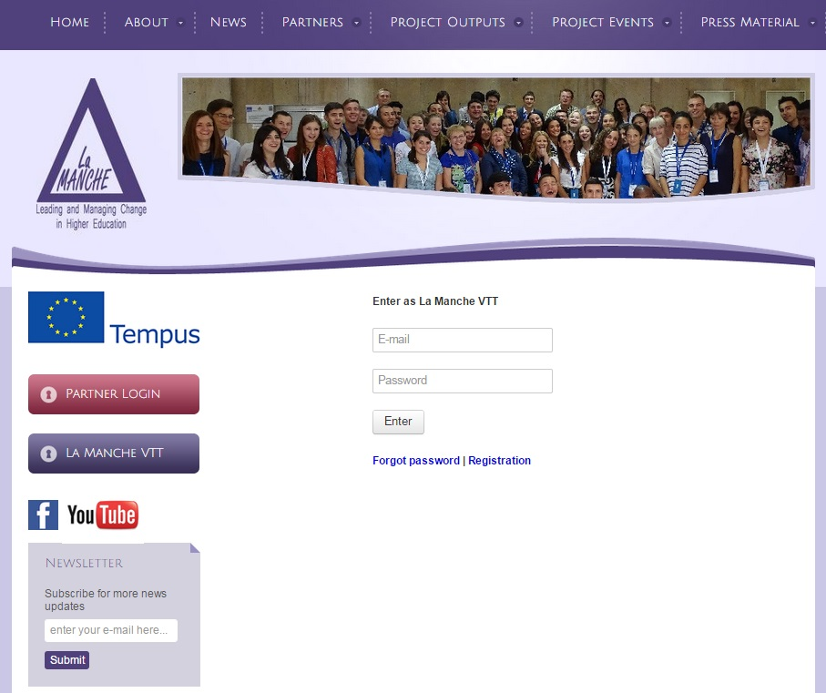
Registration at La MANCHE VTT
Registration shall be completed online at the La MANCHE project website (www.lamanche-tempus.eu) within the La MANACH VTT section. Upon initial registration the member to be is required to provide an email address and a username.

Slide 6
Membership of La MANCHE VTT
Members
Policy makers
Civil society
Student organizations
Advocates for gender equality
Leaders, (non) academic staff
Business representatives

Slide 7
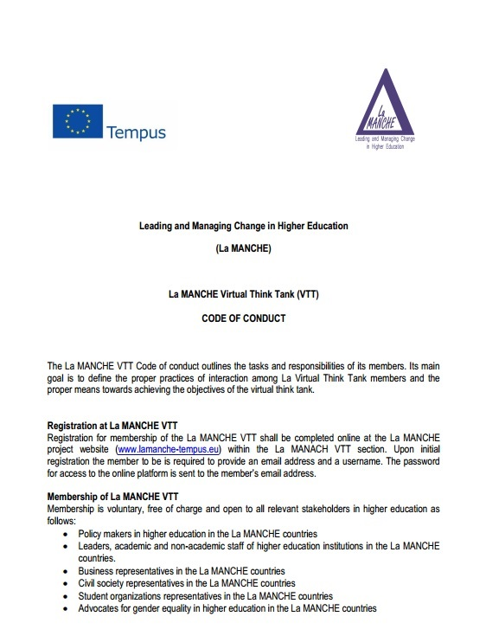
Necessary information
Main tasks and responsibilities
Principles of work and interaction within the La MANCHE VTT
La MANCHE Virtual Think Tank (VTT)
CODE OF CONDUCT

Slide 8
Thank You for attention!
Prepared by:
La MANCHE Project-members:
Larysa Merkulova
Dmytro Skliar

